Slide 1
Project
GoGym
“Keep up the grinding smartly”

Slide 2
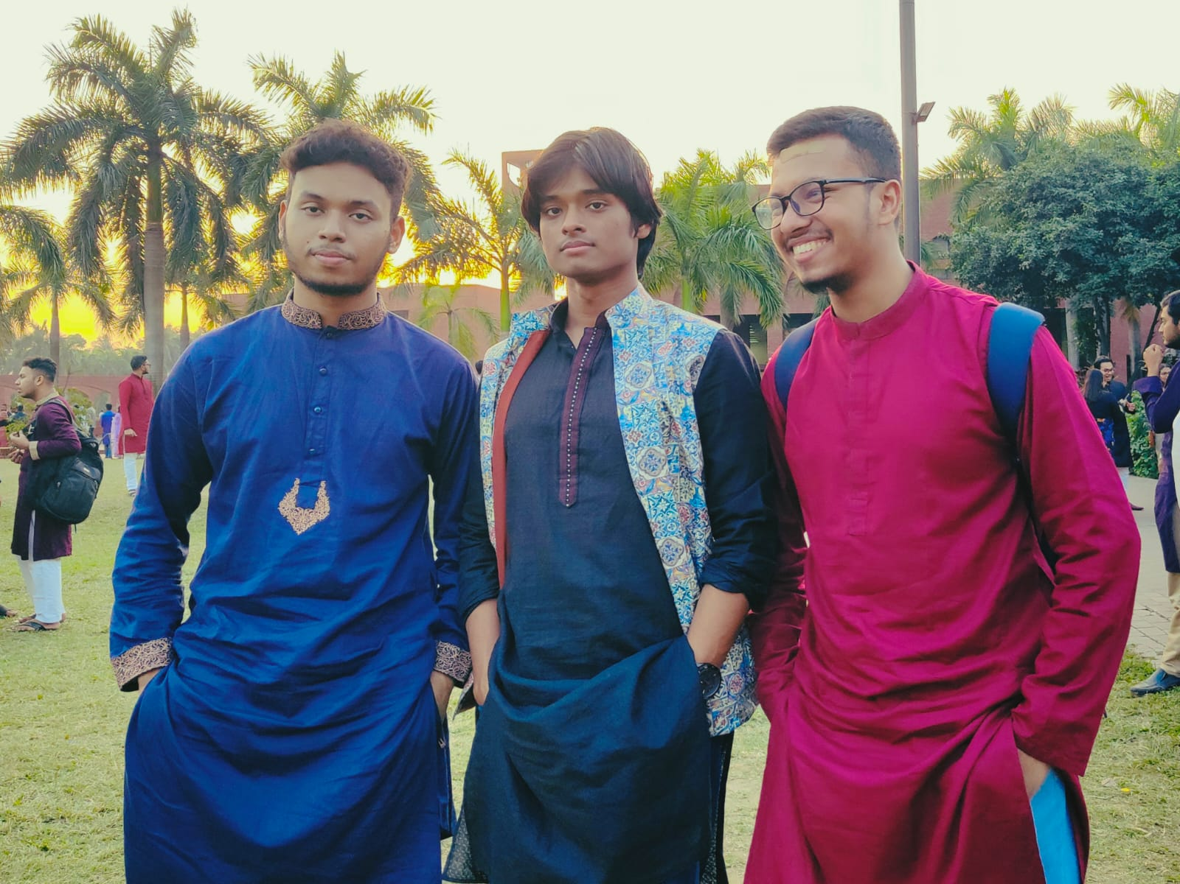
Members
(From left to right)
Nayeemul Hasan Prince (220041125)
Obidit Islam (220041154)
Rahinur Bin Naushad (220041118)

Slide 3
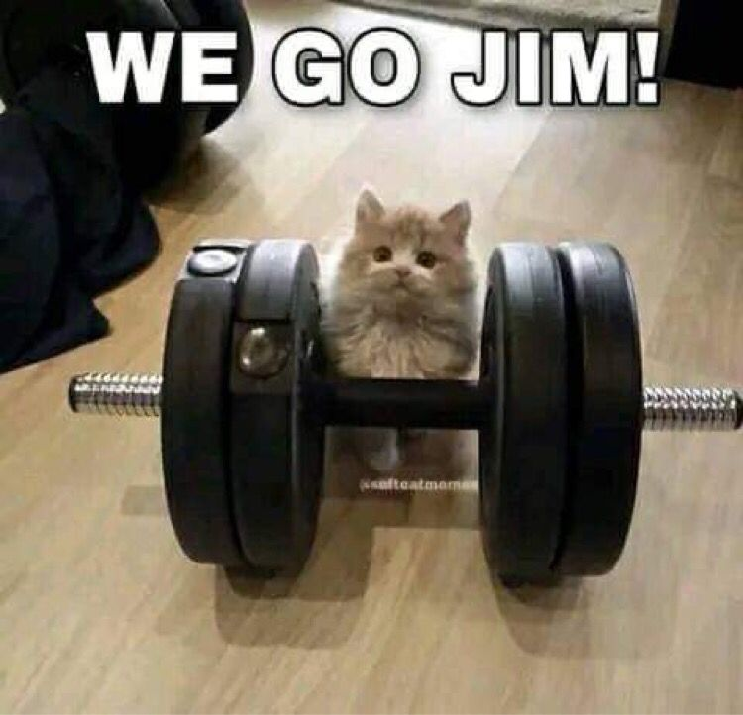
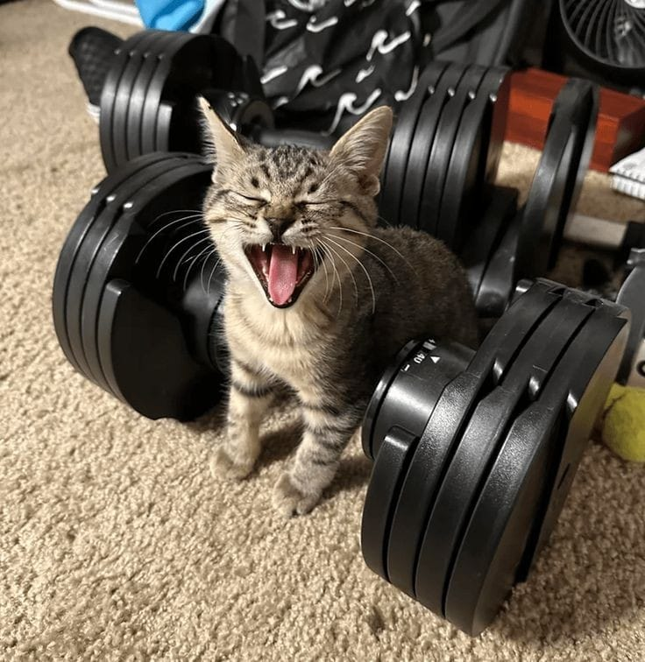
Motivation
Going to gym can be a fundamental part of human life. Most of the gyms in our country is inadequate and don’t follow a proper technological system here. That can be a problem for the admin panel and manager to go through all members information and their membership timeline as well.
We are here to present ‘GoGym’ to you, a smart gym management system, where not only admin panel have the benefits to manage all the information of members but also members can have their own user interface and see their workout plan as well.
LET’S BE STRONG

Slide 4
Key Features
Admin Panel
Mainly two parts
Admin Panel
Member Panel

Slide 5
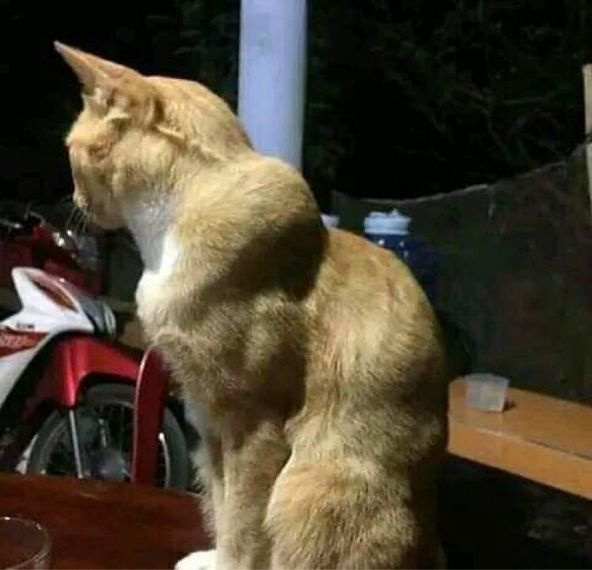

Features of Admin Panel
That one guy in the gym:
Gain access through members given information
Billing system and history
Assigned workout plan and list
Other necessary information
Disclaimer: Some features might be added or deleted depending on the flow of the project.
Me looking at that guy:

Slide 6
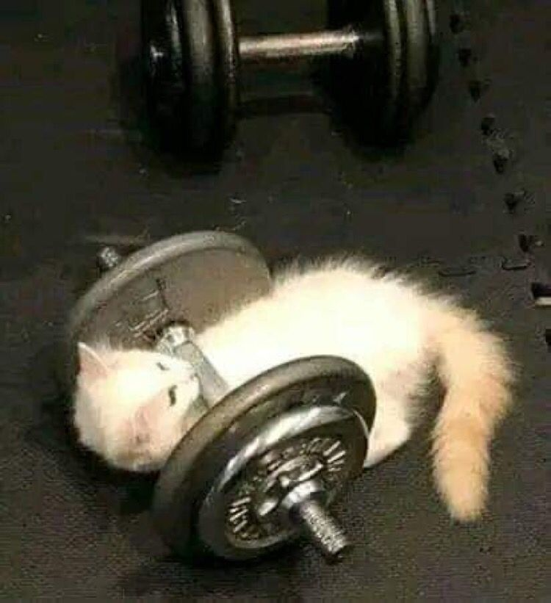
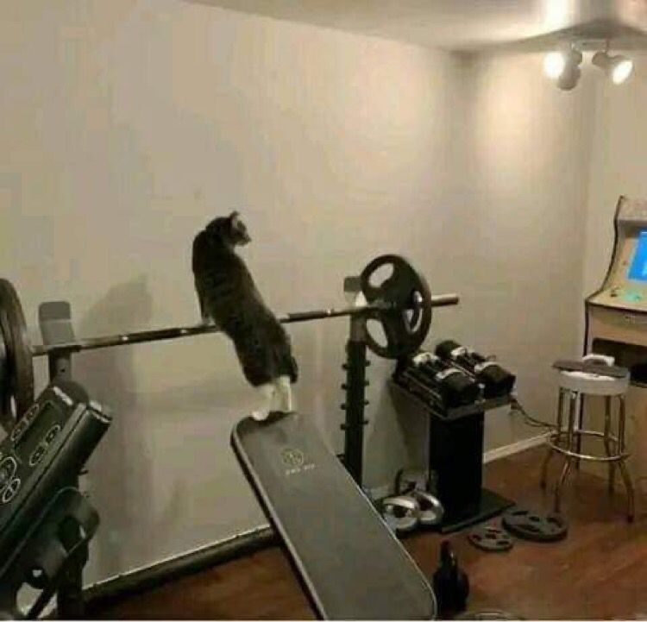
Features of Member Panel
Me on the first day:
Unique and Aesthetic User Interface
Membership History
Assigned Workout and Routine
Disclaimer: Some features might be added or deleted depending on the flow of the project.

Slide 7
Tools and Technologies
Programming Language: C
C Standard Libraries (stdio.h, stdlib.h… whatever we need) .
For UI, SDL2 or OpenGL.
We will use whatever we need depending on the flow of the project while keeping the source code in C Programming Language strictly as we are assigned.

Slide 8
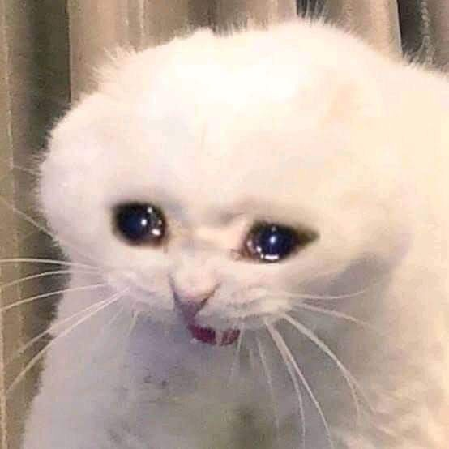
Prototype
No prototype yet. We just came up with this idea like a couple days ago.
Hopefully it will be a successful project .

Slide 9
Task Distribution
As for task distribution, we still haven’t really settled down on how we are going to divide it in three ways. But we will figure it out in some way. But there’s a few things we will ensure:
The work pressure must not be on one personal unfairly more.
Contributing in the main source code equally.
One of us will maintain UI Designs. (Most likely Obidit)
One or two of us will keep debugging the code and explain it to the remaining members depending on the flow of the project.

Slide 10
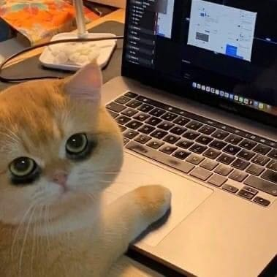
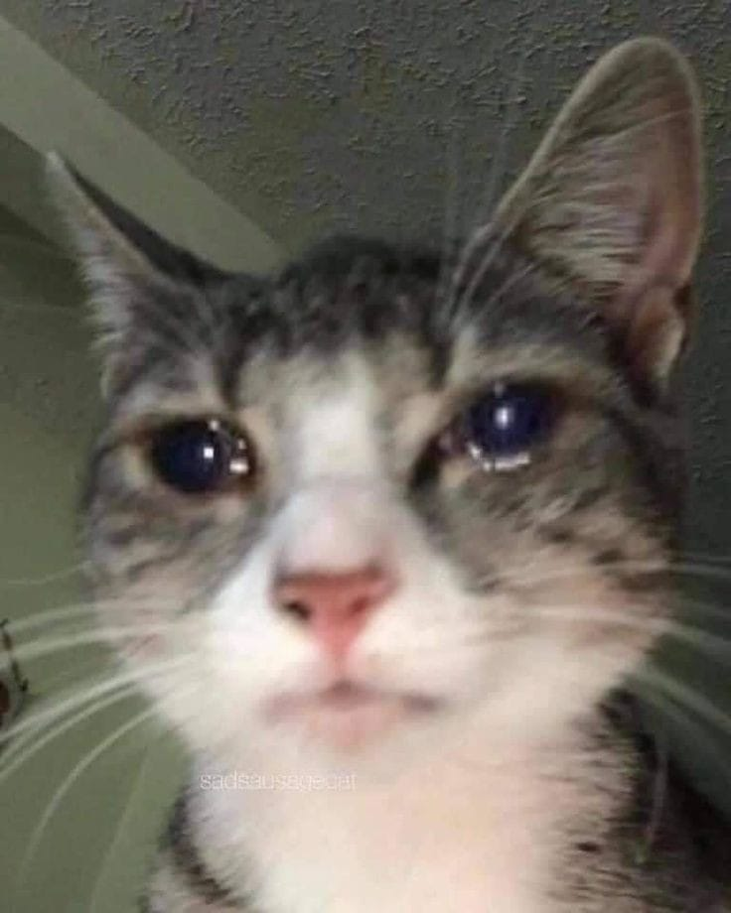
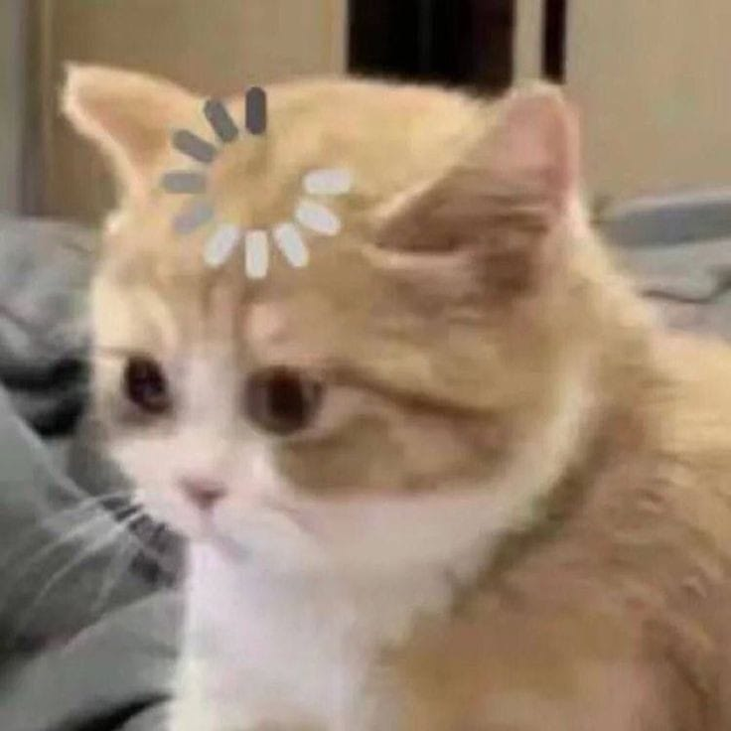
Project Timeline
From January to February 27th:
We actually couldn’t do anything. We kept brainstorming, exploring and being ambivalent with several ideas
On February 28th Morning:
Obidit making presentation.

Slide 11


Project Timeline
A
Phase 1:
We will start working on our main source code and progress it as much as possible from 13th March to 17th March. Basically we have to sacrifice the little much vacation we are getting after mid semester.
Phase 2: From 18th March to 10th April (During Ramadan)
We will consistently work on the source code and expecting to finish it before Eid-Ul-Fitr. Also We will learn about designing more or less and explore to see whether we can add more features.

Slide 12
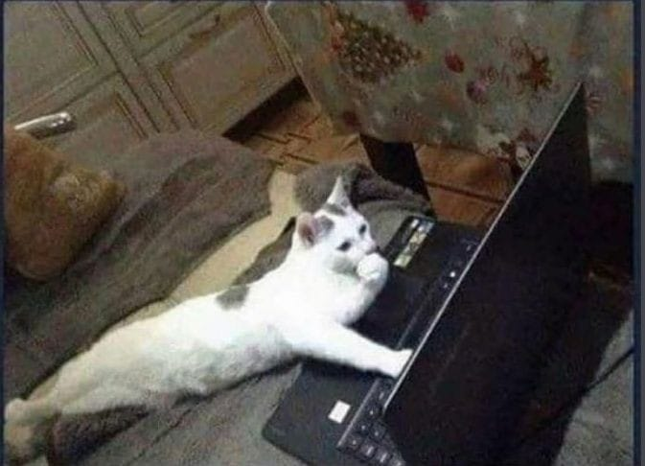
Project Timeline
Phase 3: From 22nd April to 21st May
After cooling our head for a few days during Eid, we plan to finish our work by 24th May. It will be hard to maintain academics, competitive programming and project at the same time but we will manage and keep up the good work and finish this by then.

Slide 13
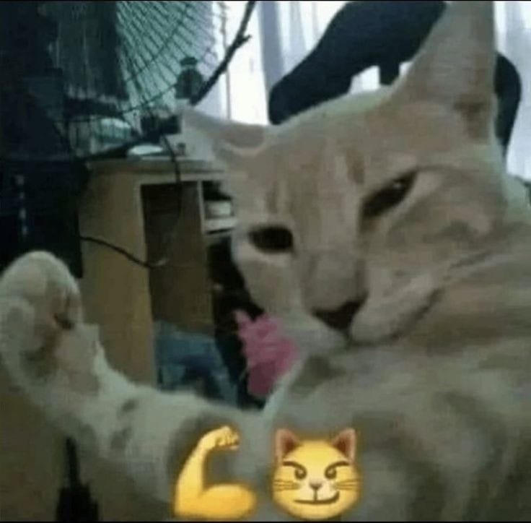
The End
Here we conclude our presentation and an uncertain start of ‘GoGym’.
Keep up the grinding smartly.

